Slide 1

Introduction
Predicting Mortality Risk in Intensive Care Unit (ICU)
Predicting mortality risk in the ICU is crucial for guiding treatment decisions, optimizing resource allocation, and improving patient outcomes by identifying high-risk individuals who may benefit from more intensive care.
Notes:
Preprocessing data, modeling, fine-tuning, and evaluation are four essential steps in developing an AI model. In this presentation, we will cover these steps in detail to provide you with a comprehensive understanding of AI modeling.

Slide 2

Presentation Overview
Data Preprocessing – Keith Chan Data preprocessing is a vital phase in AI modeling that encompasses the cleaning and transformation of data to make it suitable for analysis. This step is essential for ensuring the model's accuracy and effectiveness.
Modeling – John Wong & Giselle Chan Modeling entails selecting an appropriate model architecture and training it using the preprocessed data. This phase is crucial for developing a precise and efficient AI model.
Evaluation & Conclusion – Giselle Chan Evaluation involves testing the AI model on new data to measure its accuracy and effectiveness. This step is critical for confirming that the model is both reliable and efficient in real-world applications.
Notes:
Preprocessing data, modeling, fine-tuning, and evaluation are four essential steps in developing an AI model. In this presentation, we will cover these steps in detail to provide you with a comprehensive understanding of AI modeling.

Slide 3
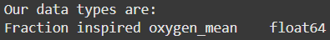
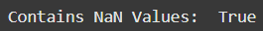
Data Pre-processing
Handling Null Values by K-Nearest Neighbours (KNN) Imputation
K-Nearest Neighbours (KNN) imputation fills in missing values by leveraging similar instances in a dataset. It identifies the 'k' nearest neighbors of a data point with missing values and estimates them using averaging for continuous variables or majority voting for categorical ones. This technique helps maintain dataset integrity and can improve the accuracy of subsequent analyses by utilizing relationships within the data.
Notes:
Data preprocessing is the process of transforming raw data into a format that can be easily used for modeling. We will explore the different techniques used for data preprocessing, such as data cleaning, feature scaling, and feature selection.

Slide 4
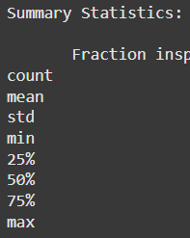
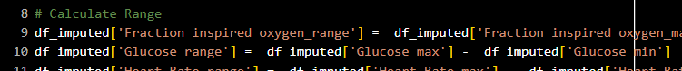
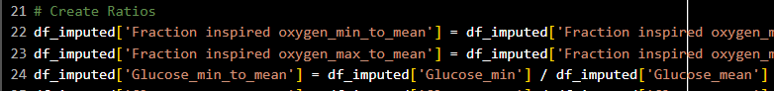
Data Pre-processing
Creating ‘range’, ‘min to mean’, and ‘max to mean’
Creating 'range', 'min to mean', and 'max to mean' metrics helps summarize the distribution and variability of a dataset, providing insights into data spread and central tendency. The 'range' indicates the extent of variation between the minimum and maximum values, while 'min to mean' and 'max to mean' ratios illustrate how the extreme values relate to the average, highlighting potential skewness or outliers. These metrics enhance data understanding and facilitate better decision-making in analyses by allowing for a more nuanced interpretation of the data's characteristics.
Notes:
Data cleaning involves removing or correcting inaccurate, incomplete, or irrelevant data. We will discuss different techniques used for data cleaning, such as handling missing values, smoothing noisy data, and removing outliers.

Slide 5
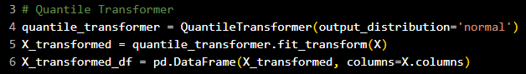
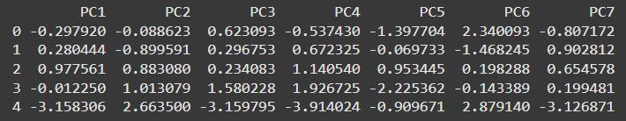
Quantile Transformer
Data Pre-processing
A quantile transformer is a preprocessing technique that transforms features to follow a uniform or normal distribution by mapping the original values to their quantiles. This helps stabilize variance and make the data more suitable for algorithms that assume a Gaussian distribution, improving model performance and interpretability.
Notes:
Feature scaling is the process of normalizing the range of features. We will explore different techniques, such as normalization and standardization, that are used for feature scaling.

Slide 6
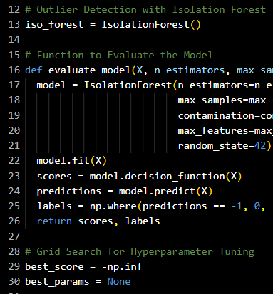
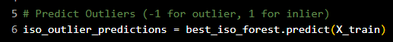
Data Pre-processing
Finding Anomalous Data Points by Isolation Forest
Isolation Forest is an anomaly detection algorithm that identifies outliers by isolating observations in the data. It works by randomly selecting features and splitting values, creating a tree structure where anomalies are expected to require fewer splits to isolate compared to normal observations, making it efficient and effective for detecting anomalies in large datasets.
Notes:
Feature selection is the process of selecting a subset of relevant features for use in modeling. We will discuss different techniques used for feature selection, such as filter methods, wrapper methods, and embedded methods.

Slide 7
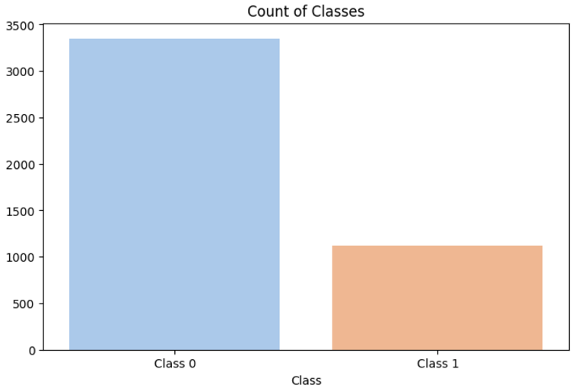
Synthetic Minority Over-sampling Technique (SMOTE)
Data Pre-processing
SMOTE is a technique used to address class imbalance in datasets by generating synthetic samples for the minority class. It creates new instances by interpolating between existing minority class samples, helping to improve the performance of machine learning models on imbalanced datasets.
Notes:
Modeling is the process of selecting an appropriate algorithm and applying it to a dataset to create a model. We will explore different types of models, such as linear regression, logistic regression, and decision trees.

Slide 8
Probit vs Logistic Model

Slide 9
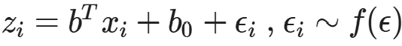
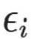
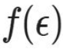
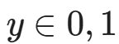
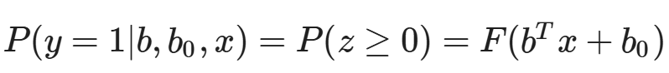
Latent Variable Model
Consider the linear Latent Variable Model:
Mapping features x to latent subspace z
[b b₀] is the parameters, is the error term following the distribution
We considered the standard normal distributions (Probit Model) and standard logistic distributions (Logistic Model)
The prediction for is given by:

Slide 10
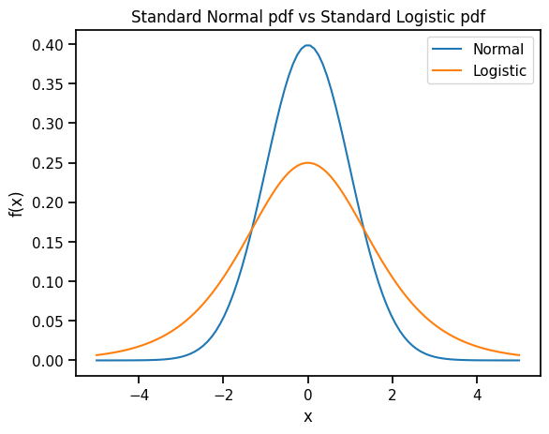
Normal Distribution vs Logistic Distribution
Standard logistic distribution has a wider tail than standard normal distribution
captures factors not explained by features x
If unexplained factors are i.i.d and have finite variance, by CLT, better to model as standard normal error

Slide 11
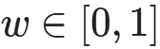
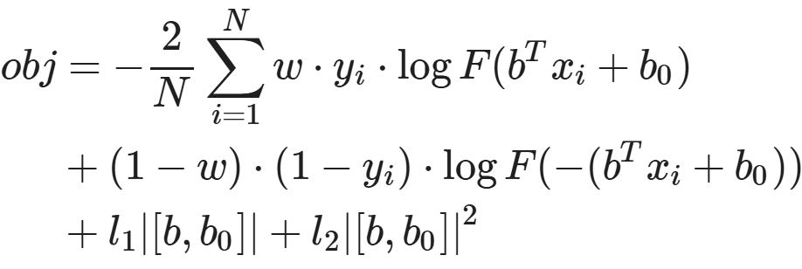
Likelihood and Objective Functions
The negative log likelihood is:
Since our predicted class is imbalanced, we added a weight to balance the contribution of each class to the loss
Also adding L1/L2 regularization terms, the objective to minimize is:
Optimizer: SLSQP
~75%
~25%

Slide 12
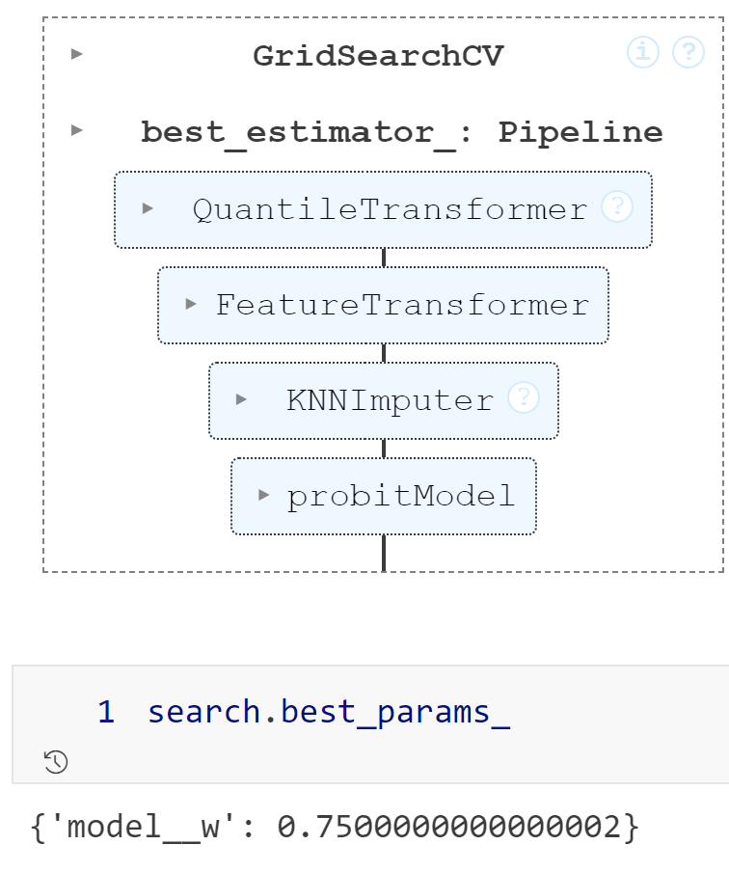
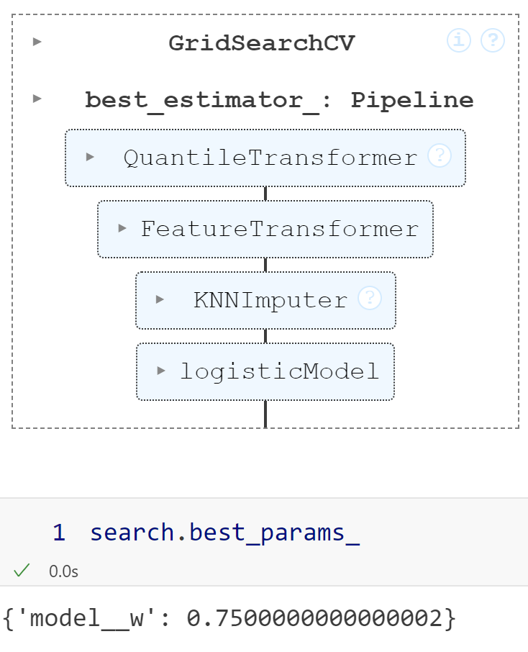
Hyperparameter Search
Neighbor, l1, and l2 are searched by Bayesian Optimization (more details next section)
l1 and l2 close to 0 for both Probit and Logistic model
Linear model: don't expect overfitting
Initial guess: w = 0.75
Cinfirmed by GridSearchCV
 | Probit | Logistic
n_neighbors (for KNN imputer) | 11 | 14
l1 | 0.00617 | 0.00274
l2 | 0.04057 | 0.00904

Slide 13
Result and Comparison
 | Probit Model | Logistic Model
F1 score | 0.47780 ± 0.01337 | 0.47644 ± 0.01573
AUC | 0.68860 ± 0.02094 | 0.69117 ± 0.01810
Precision | 0.37777 ± 0.01301 | 0.38676 ± 0.01482
Recall | 0.65018 ± 0.01499 | 0.628268 ± 0.02206
Accuracy | 0.64370 ± 0.01357 | 0.656804 ± 0.01481
Imbalanced class: Ignore accuracy, not informative
Probit Model: Higher F1 score, higher recall
Logistic Model: Higher AUC, Higher precision
Prediction threshold set to 0.5

Slide 14
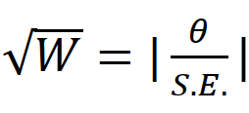
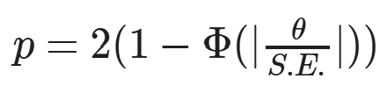
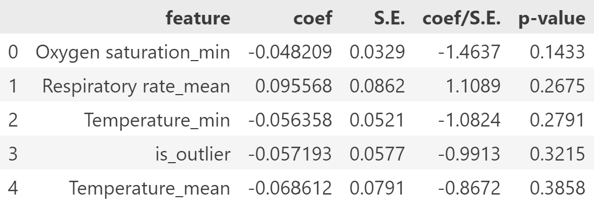
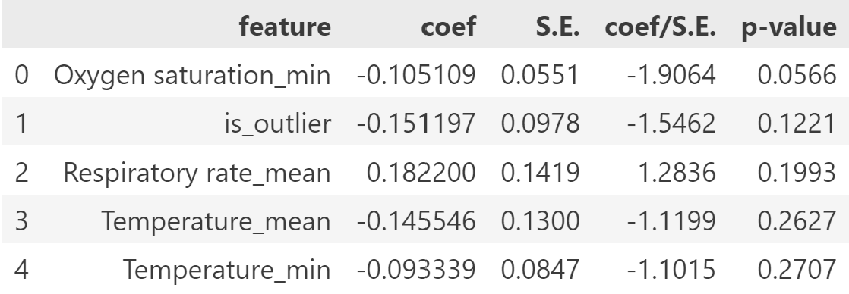
Model Interpretation
Wald Statistic:
Perform Wald test to assess feature significance
Lower p-value -> more significant that feature affect prediction
Positive coef -> higher feature value, higher mortality risk
Negative coef -> higher feature value, lower mortality risk
P-Value:
Top 5 features of probit model
Top 5 features of logistic model

Slide 15
LightGBM model

Slide 16
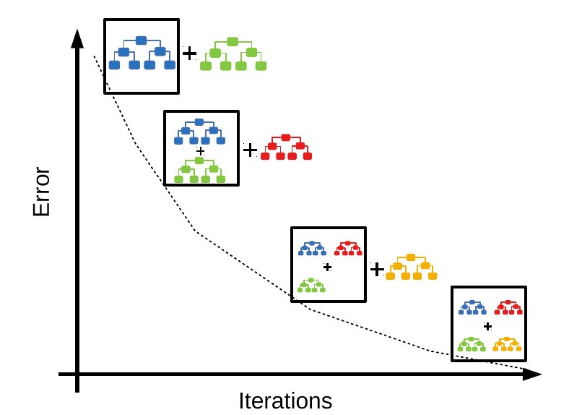


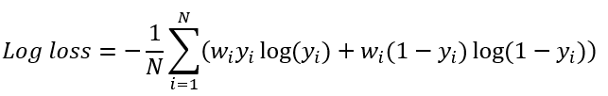
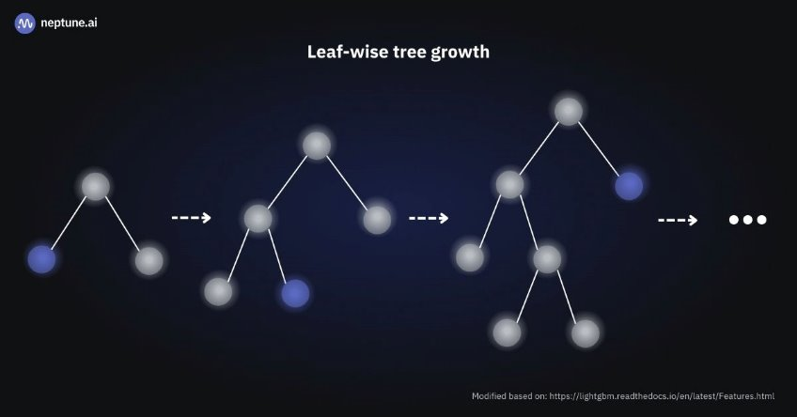
LightGBM Model
Leaf-wise
fast and memory efficient tree model
Easy to over-fit
Objective function: binary classification
Evaluation function: f1score
Gradient boosting method: DART (Dropouts meet Multiple Additive Regression Trees)

Slide 17

Model pipeline
Data preprocessing
Prediction result & evaluation
Hyperparameter tuning
Model training & Cross validation

Slide 18
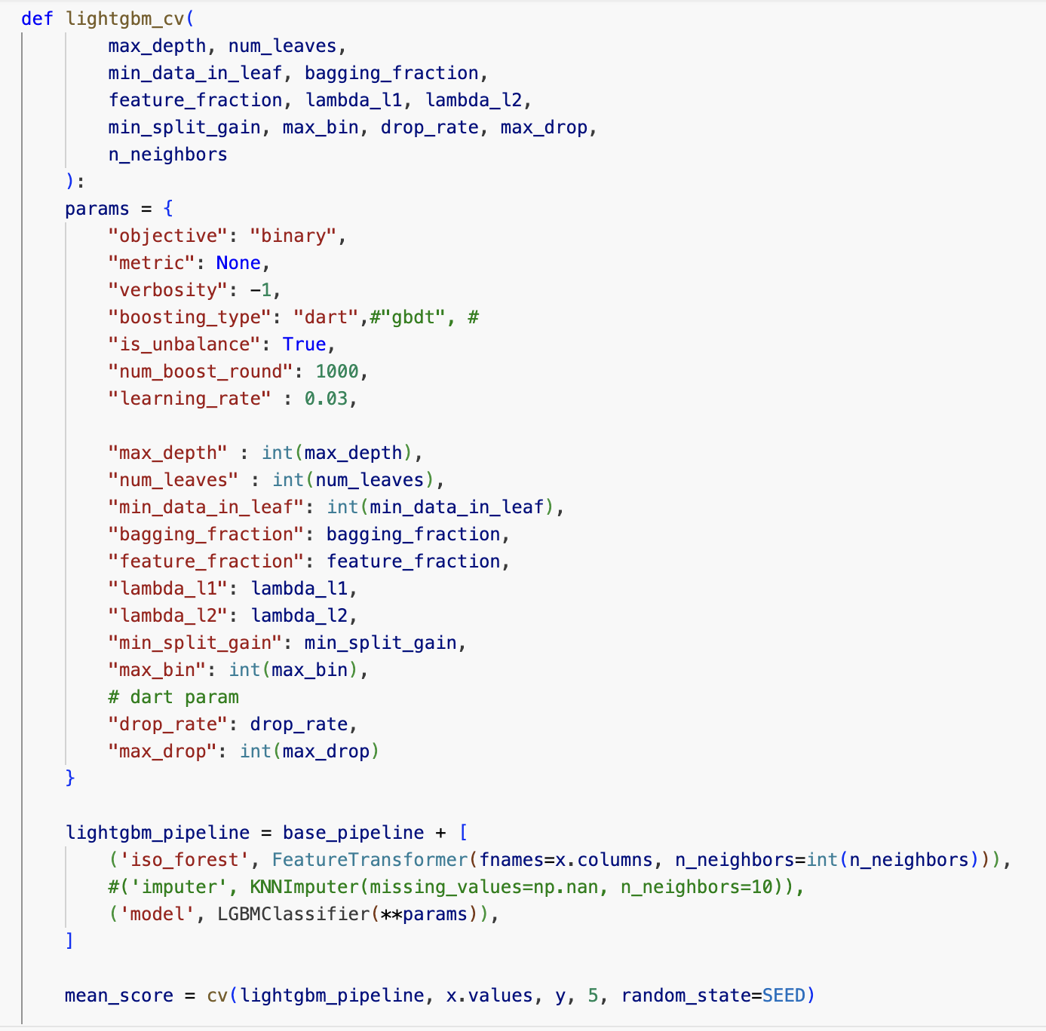
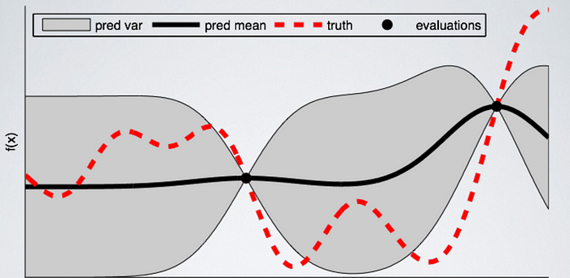
Hyperparameters tuning
Bayesian optimization
- blackbox function to search for optimal parameters
- by cross validation (F1 score)
Hyperparameters tuning (Bayesian optimization)
n_neighbors: 16 | bagging_fraction:0.59
lambda_l1:4.45 | lambda_l2: 4.63
max_bin: 67 | feature_fraction: 0.55
drop_rate:0.36 | Max_drop:27
max_depth: 3 | num_leaves:71
Notes:
https://towardsdatascience.com/a-conceptual-explanation-of-bayesian-model-based-hyperparameter-optimization-for-machine-learning-b8172278050f

Slide 19
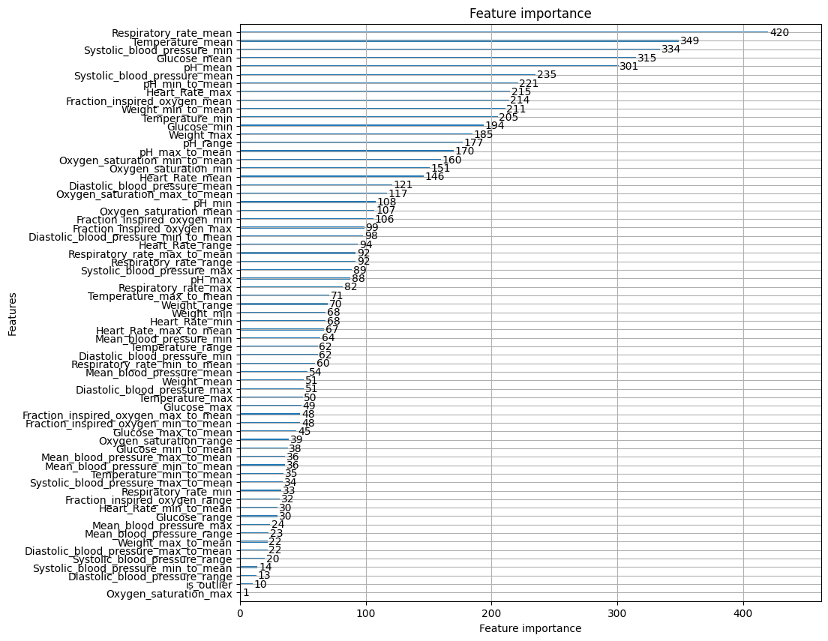
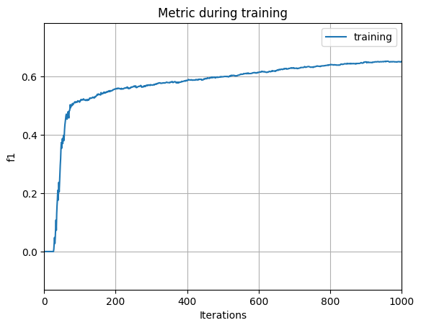
Feature importance

Slide 20
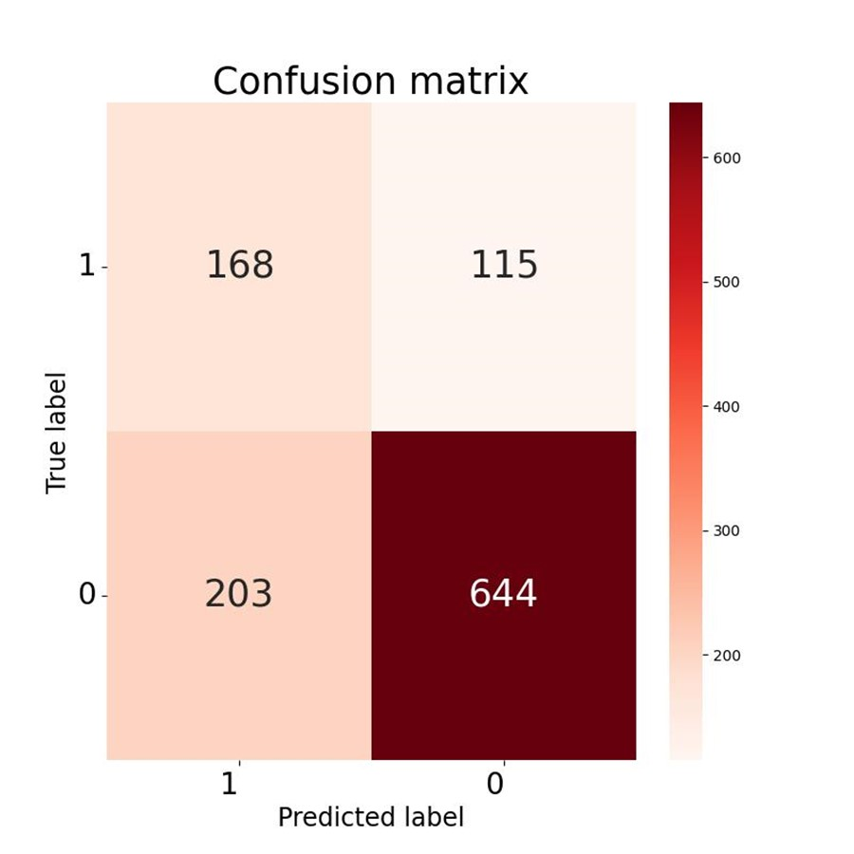
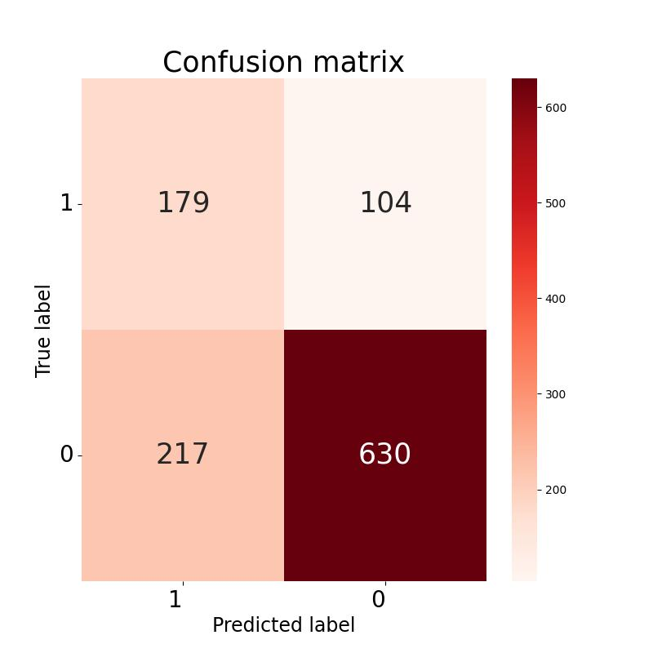


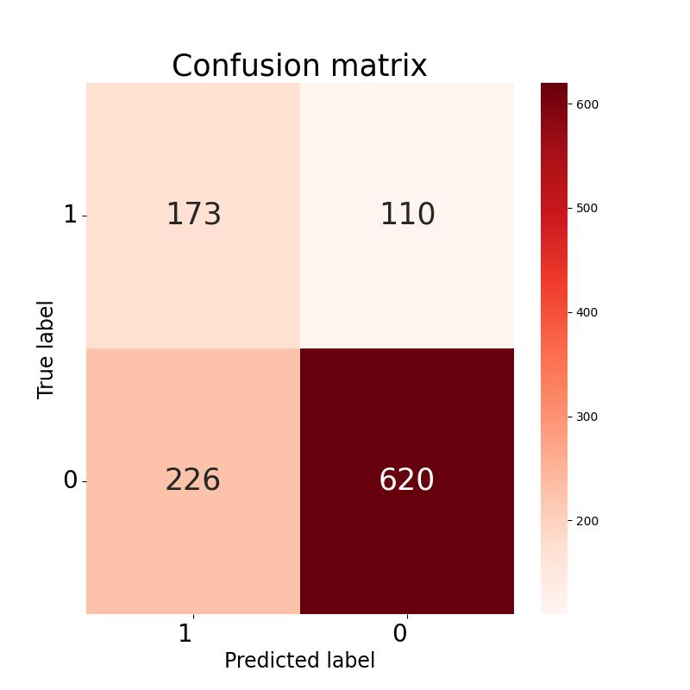
Confusion Matrix Stratified 5-fold validation

Slide 21
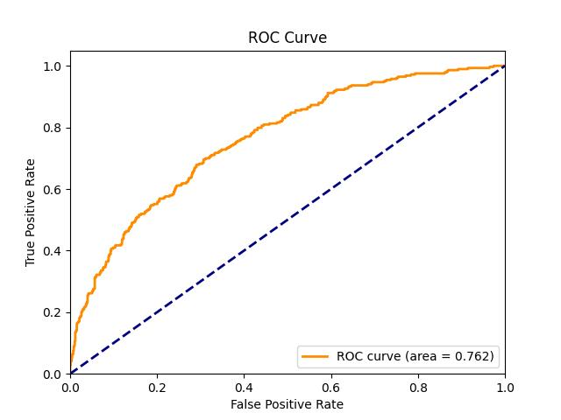
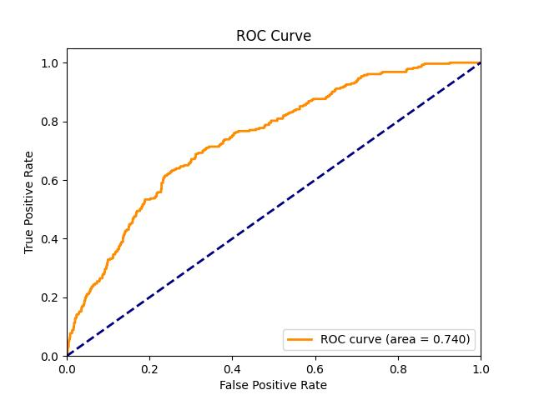

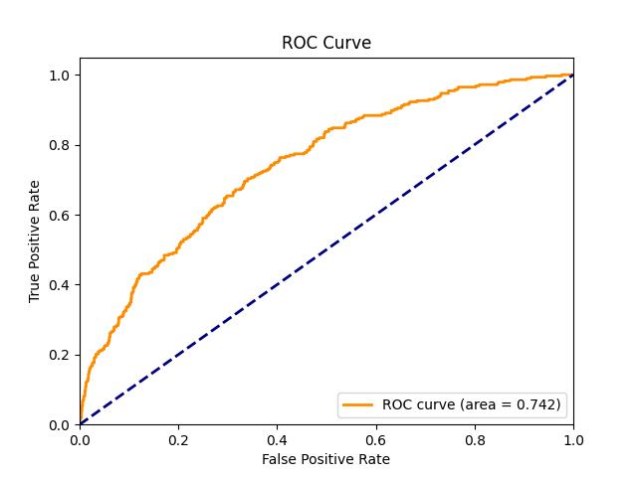
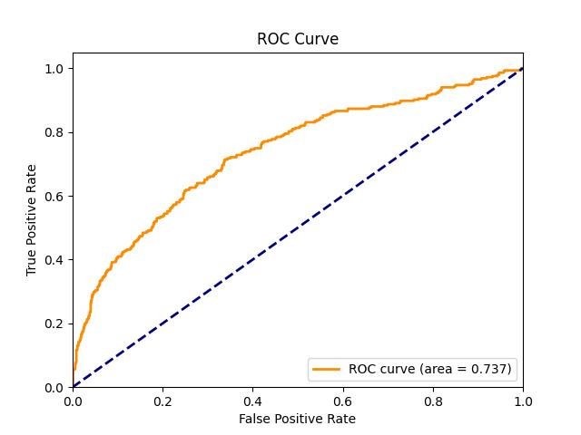
ROC Stratified 5-fold validation
Mean AUC score: 0.74691, std: 0.00937

Slide 22
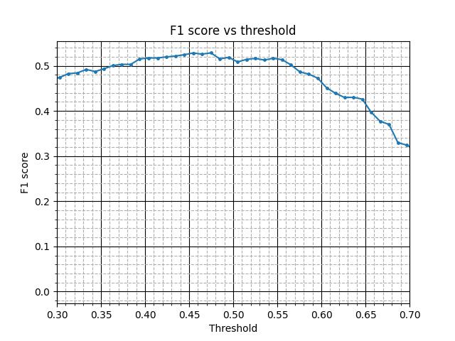
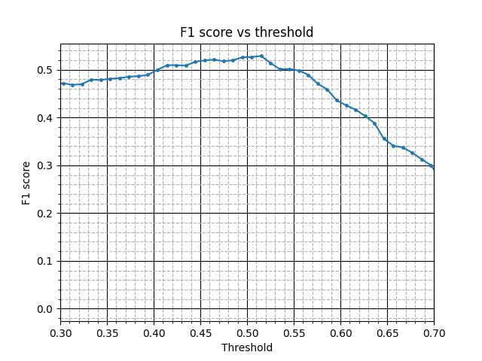
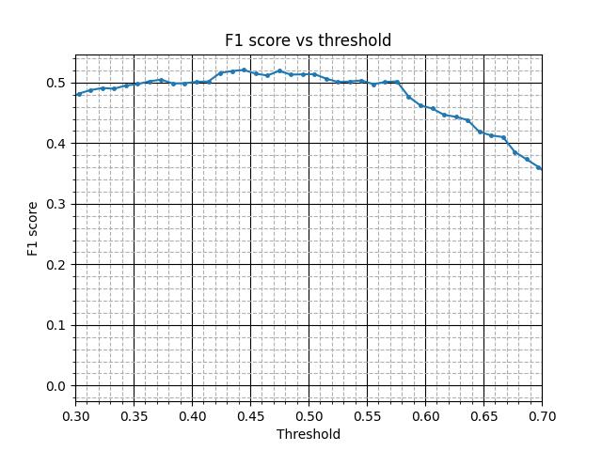
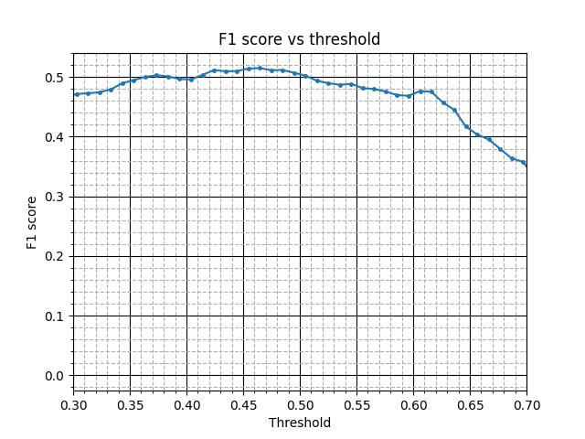
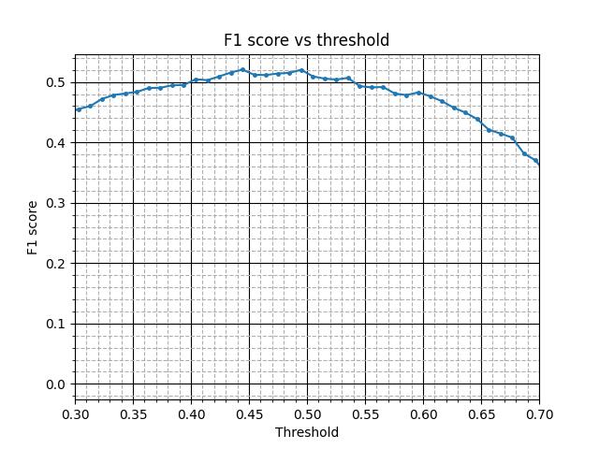
F1 vs threshold Stratified 5-fold validation
0.5

Slide 23
Models evaluation

Slide 24
Model scores comparison
 | Probit Model | Logistic Model | LightGBM Model
Hyperparameters | l1= 0.00617, l2= 0.04057, n_neighbors=11 | l1=0.00274, l2= 0.00904, n_neighbors=14 | l1= 4.45330,l2=4.63382, n_neighbors=16
F1 score | 0.47780 ± 0.01337 | 0.47644 ± 0.01573 | 0.51456 ± 0.00686
AUC | 0.68860 ± 0.02094 | 0.69117 ± 0.01810 | 0.74691 ± 0.00937
Precision | 0.37777 ± 0.01301 | 0.38676 ± 0.01482 | 0.44828 ± 0.00754
Recall | 0.65018 ± 0.01499 | 0.628268 ± 0.02206 | 0.60424 ± 0.01596
Accuracy | 0.64370 ± 0.01357 | 0.656804 ± 0.01481 | 0.71436 ± 0.00615

Slide 25
Test result (LightGBM Model)
Count
Mortality

Slide 26

Conclusion
Continuous capturing useful data
data engineering
Reliable AI model prediction
recall, precision, f1-score
Compatible with growing data
hyperparameter tuning
regularization(not easily underfitting/over-fitting)

Slide 27
References
1. “sklearn.preprocessing.QuantileTransformer,” scikit-learn, [Online]. Available: https://scikit-learn.org/dev/modules/generated/sklearn.preprocessing.QuantileTransformer.html. [Accessed: Nov. 19, 2024].
2. “sklearn.ensemble.IsolationForest,” scikit-learn, [Online]. Available: https://scikit-learn.org/dev/modules/generated/sklearn.ensemble.IsolationForest.html. [Accessed: Nov. 19, 2024].
3. “imblearn.over_sampling.SMOTE,” imbalanced-learn, [Online]. Available: https://imbalanced-learn.org/stable/references/generated/imblearn.over_sampling.SMOTE.html. [Accessed: Nov. 19, 2024].
4. J. L. Horowitz and N. E. Savin, “Binary Response Models: Logits, Probits and Semiparametrics,” Journal of Economic Perspectives, vol. 15, no. 4, pp. 43–56, Dec. 2001, doi: 10.1257/jep.15.4.43.
5. Fernando Nogueira. (2014–). Bayesian Optimization: Open source constrained global optimization tool for Python.
6. “sklearn.model_selection.StratifiedKFold,” scikit-learn, [Online]. Available: https://scikit-learn.org/dev/modules/generated/sklearn.model_selection.StratifiedKFold.html. [Accessed: Nov. 19, 2024].
7. Davidson, R. and J. G. MacKinnon. Econometric Theory and Methods. Oxford, UK: Oxford University Press, 2004.
8. G. Ke et al., “LightGBM: a highly efficient gradient boosting decision tree,” in Proceedings of the 31st International Conference on Neural Information Processing Systems, 2017, pp. 3149–3157. 9. M. Filho, “LightGBM for Binary Classification in Python,” Forecastegy, Nov. 14, 2023. [Online]. Available: https://forecastegy.com/posts/lightgbm-binary-classification-python/. [Accessed: Nov. 19, 2024]. 10. K. V. Rashmi and R. Gilad-Bachrach, DART: Dropouts meet Multiple Additive Regression Trees. 2015.

Slide 28
The end

